Slide 1

Creative Coding w/ Processing
Chapin Technology Day
2019.12.13

Slide 2


Slide 3


Slide 4
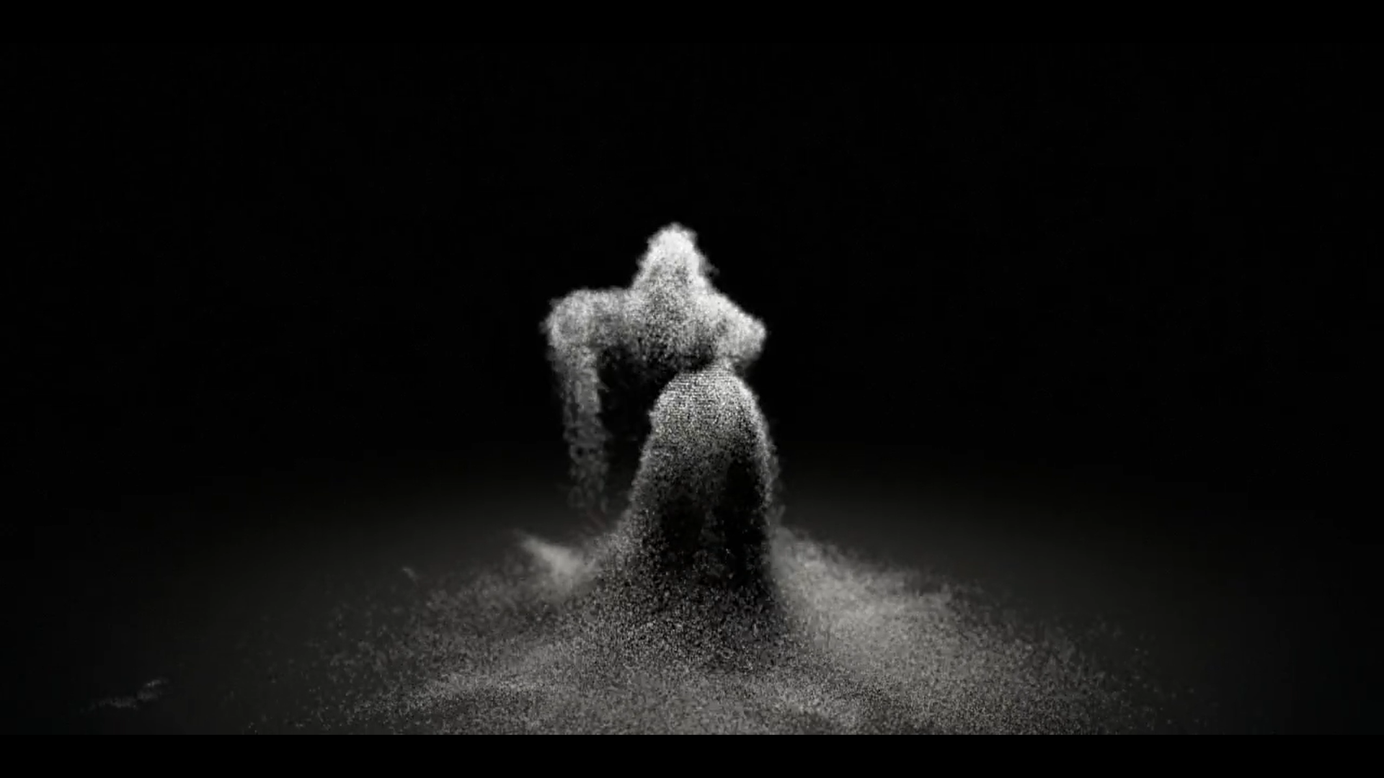

Slide 5


Slide 6


Slide 7


Slide 8
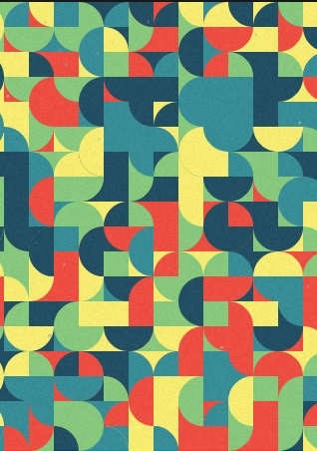

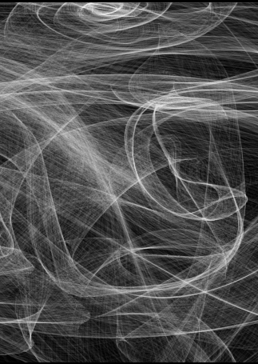
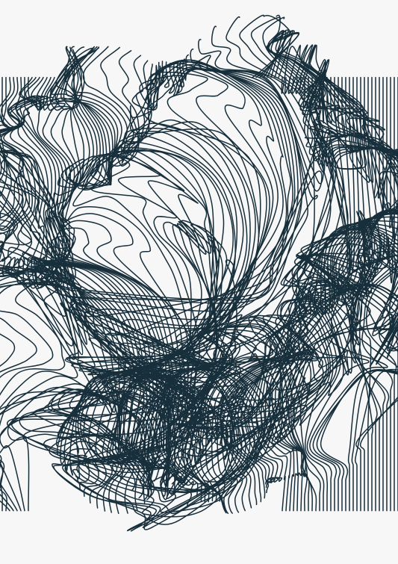
OpenProcessing.org
Lots of interesting demos and code examples to explore!
Learn from other people’s ideas and get inspired!

Slide 9
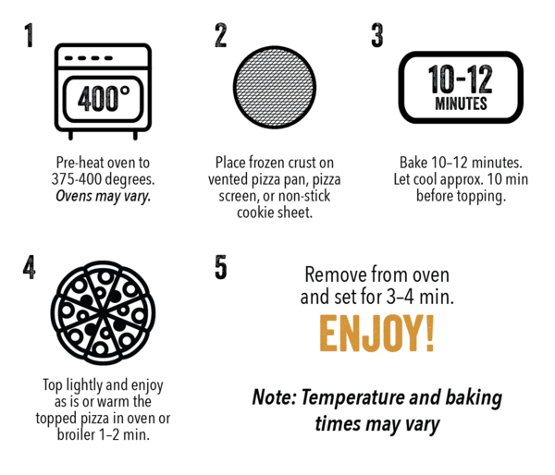
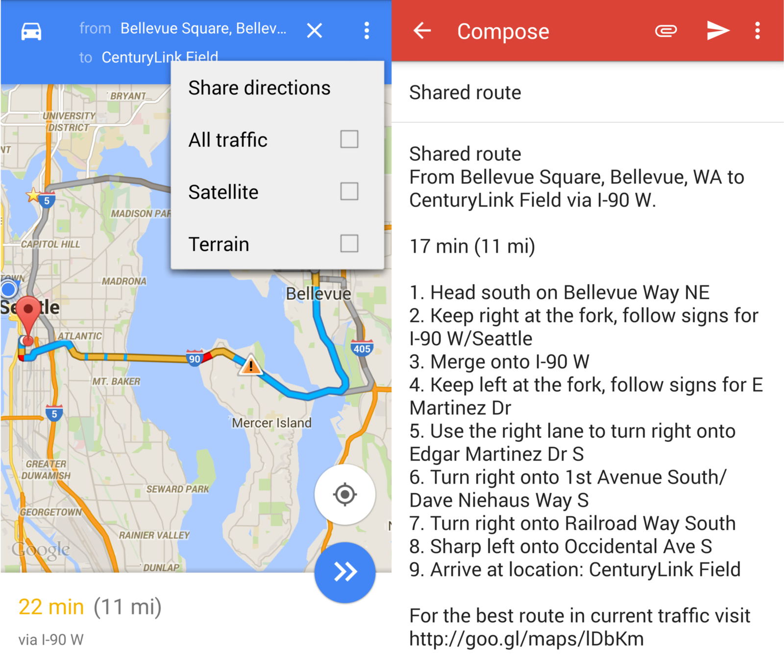
What is a “computer program”?
A computer program is a set of instructions which a computer will execute.
Recipes and map directions are like computer programs!

Slide 10
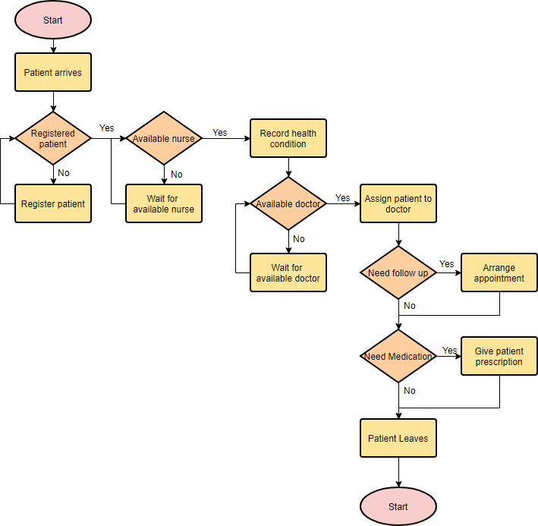
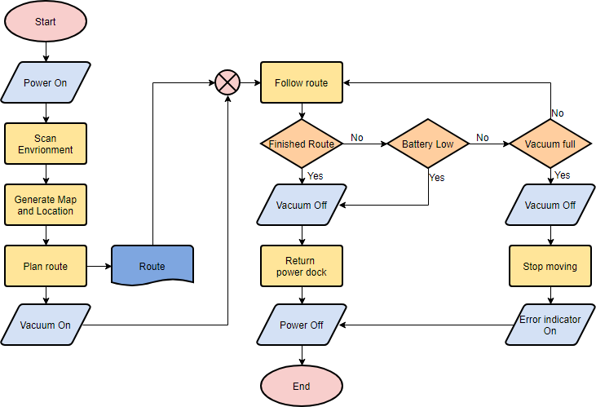
Computer programs are like complicated flowcharts which tell the computer what to do!

Slide 11
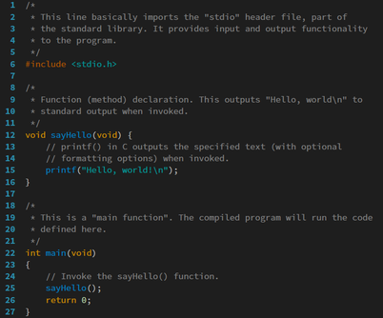
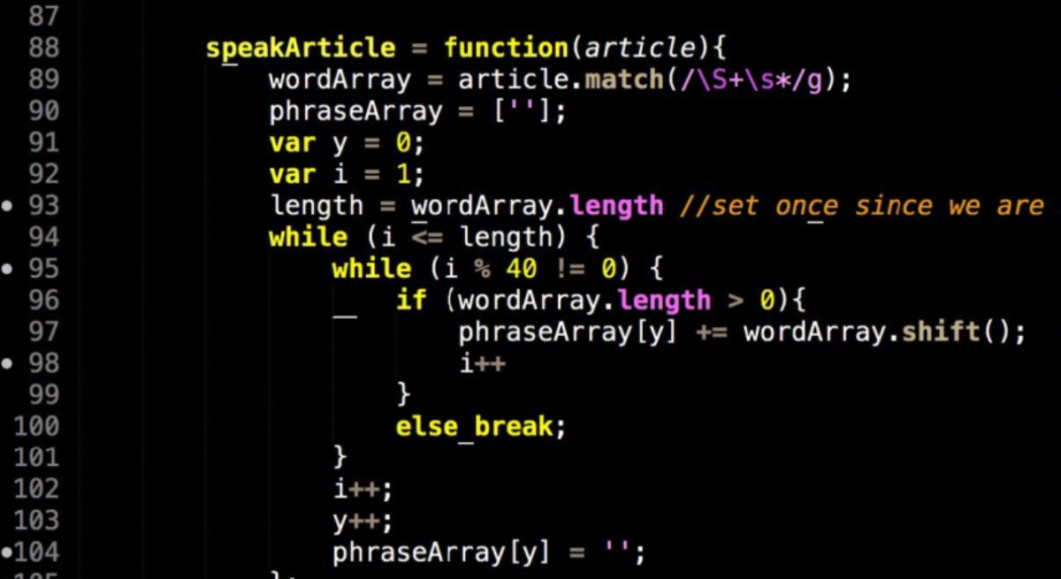
What is a “programming language”?
A system for giving the computer its flowchart instructions in a format it will understand
Syntax is a fancy word for the “grammar” of a programming language
Computer programs must perfectly follow the syntax of their language or they won’t work!

Slide 12
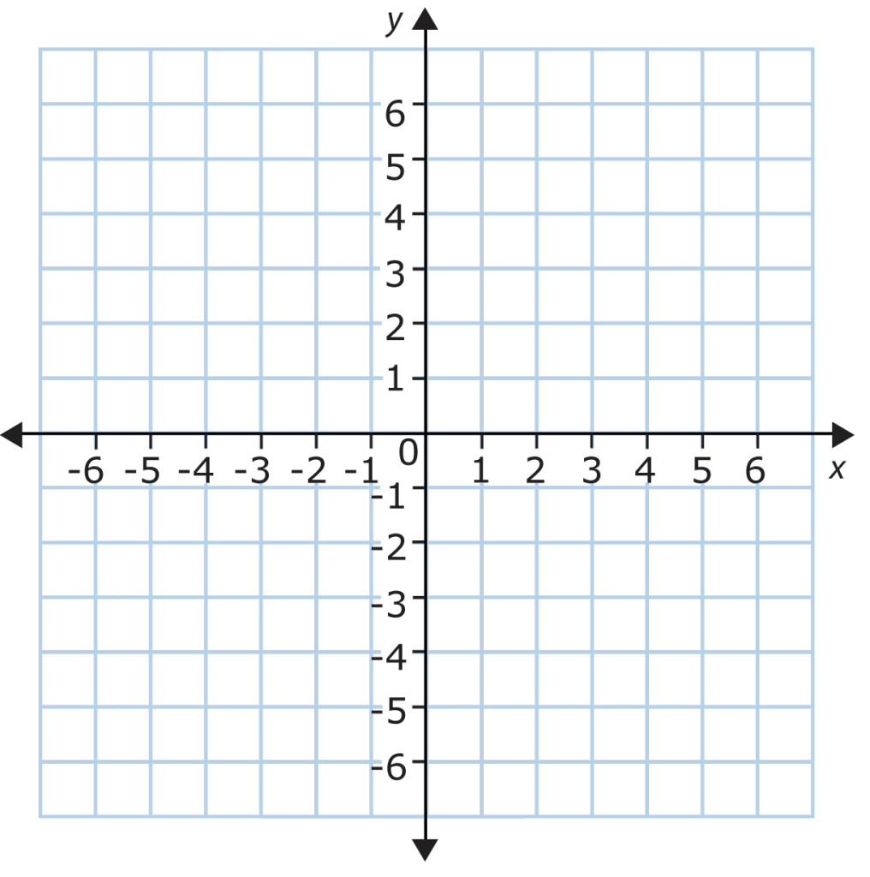
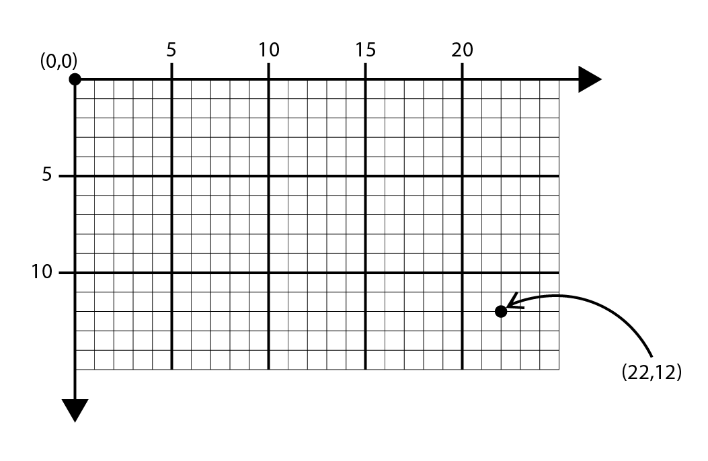
Location, Location, Location!
Processing Orientation
Normal Cartesian Grid

Slide 13
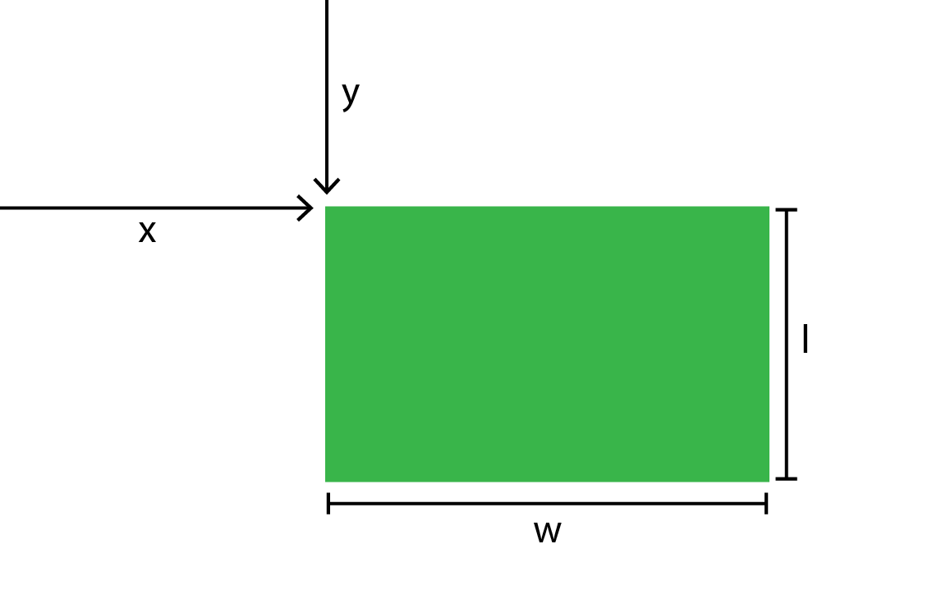
The rect function
Syntax: rect(x,y,w,l)
Function Name: rect
Argument 1: horizontal location
Argument 2: vertical location
Argument 3: Horizontal width
Argument 4: Vertical length

Slide 14
Your first line of code…
A “function” tells the computer what action to take
A function has “arguments” or “inputs” which give the computer more information about how to complete the action
Typical syntax: function(arg1, arg2,…)
pour(water, 10 mL, cup)
Function = pour
Argument 1 = material (in this case, water)
Argument 2 = amount (in this case, 10mL)
Argument 3 = destination (in this case, cup)
heat(sauce, 100 mL, 200F, stove)
Function = heat
Argument 1 = object (in this case, sauce)
Argument 2 = amount (in this case, 100mL)
Argument 3 = temperature (in this case, 200 F)
Argument 4 = device (in this case, stove)

Slide 15
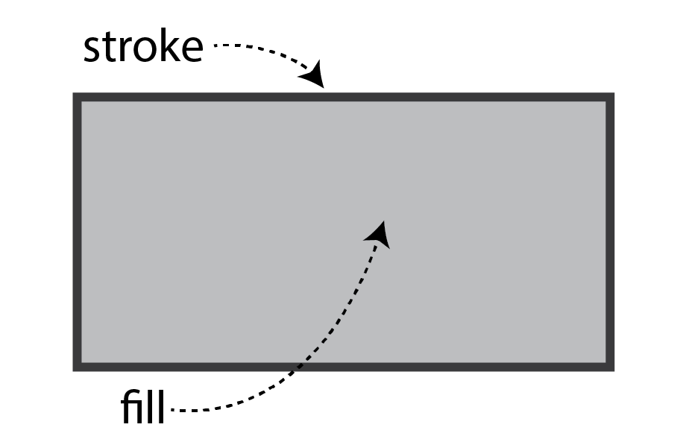
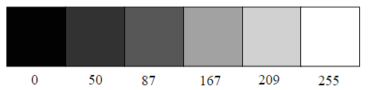
From black and white….
stroke(0-255):: sets the shade of the border
fill(0-255):: sets the shade of the interior fill

Slide 16
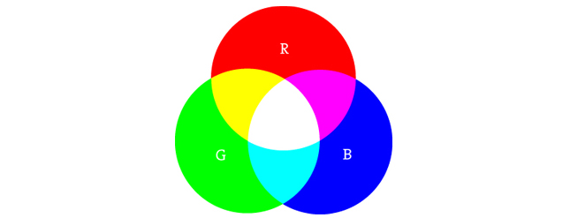
To color!
fill(0-255,0-255,0-255)
stroke(0-255,0-255,0-255)
Set the amount of red, green and blue individually!
Slider Demo

Slide 17
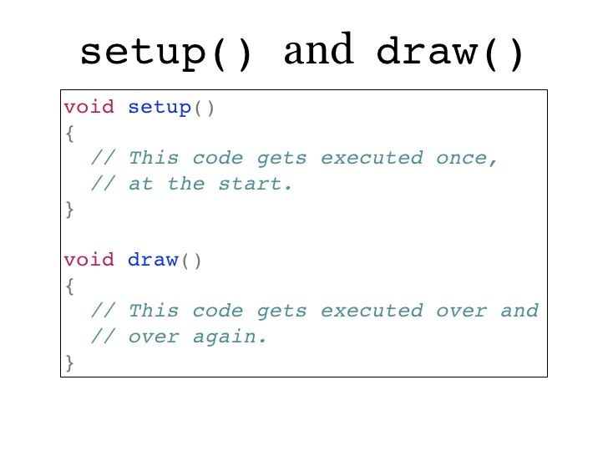
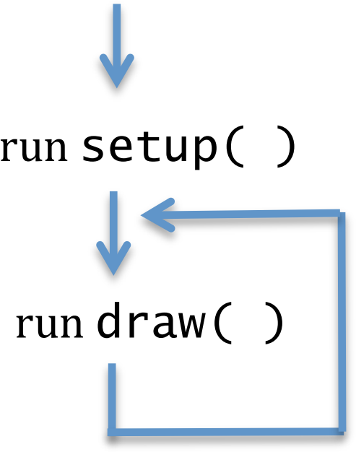
Animation!
For now, think of void like the indentation at the start of a paragraph – it’s just part of the syntax!
Curly braces indicate the start and end of the chunk of code in a given block!
setup() and draw() represent two separate “blocks” of code, like paragraphs in a book!

